Slide 1

Species Distribution Models:
History and Theory
The Wallace Team
Slide deck led by: Matthew E. Aiello-Lammens & Jamie M. Kass

Slide 2
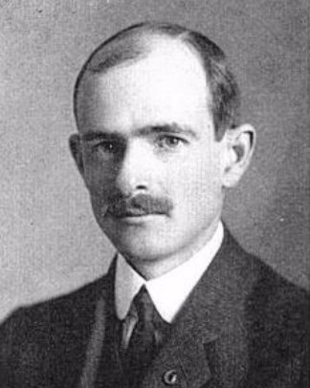
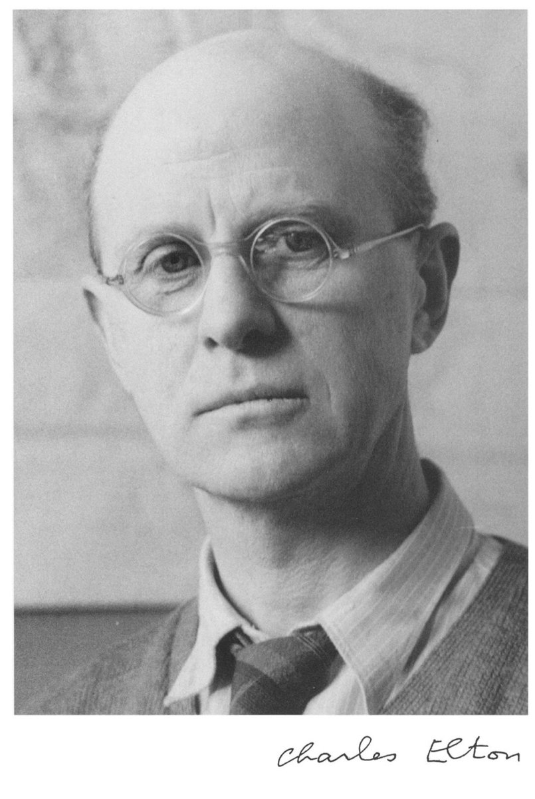
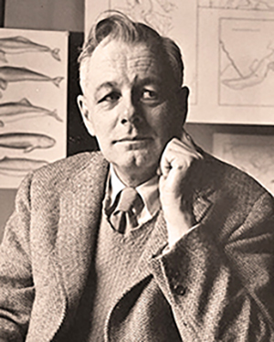
Ecological Niches
J. Grinnell
C. Elton
G.E. Hutchinson
news.yale.edu
Set of environmental variables that restrict the geographic distribution of a species due to physiological effects.
The ecological role of a species, including its interactions with other species.
N-dimensional hypervolume of environmental variables within which a species can persist indefinitely.
Notes:
Photo credits:
Left: Grinnell (public domain). Available from: https://en.wikipedia.org/wiki/File:JGrinnell1904.jpg
Middle: Elton. Available from: https://en.wikipedia.org/wiki/File:Charles_Elton.jpeg
Right: Hutchinson. Yale University manuscripts and archives (public domain). Available from: https://news.yale.edu/sites/default/files/d6_files/imce/Hutchinson-1_0.jpg

Slide 3
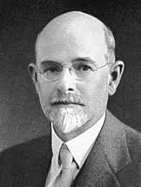
Ecological Niches
J. Grinnell
C. Elton
G.E. Hutchinson
news.yale.edu
mvz.berkeley.edu
twitter.com
Set of environmental variables that restrict the geographic distribution of a species due to physiological effects.
The ecological role of a species, including its interactions with other species.
N-dimensional hypervolume of environmental variables within which a species can persist indefinitely.
Notes:
Photo credits:
Left: Grinnell (public domain). Available from: https://en.wikipedia.org/wiki/File:JGrinnell1904.jpg
Middle: Elton. Available from: https://en.wikipedia.org/wiki/File:Charles_Elton.jpeg
Right: Hutchinson. Yale University manuscripts and archives (public domain). Available from: https://news.yale.edu/sites/default/files/d6_files/imce/Hutchinson-1_0.jpg

Slide 4
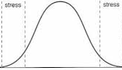
Relationships between ecological niches and geographic distributions
RANGE OF PHYSIOLOGICAL TOLERANCE
N-DIMENSIONAL HYPERVOLUME
Precipitation
Optimal zone
Intolerance zone
Stress zone
Intolerance zone
Stress zone
Humidity
Low
High
Temperature
Environmental gradient (e.g. temperature, precipitation)
Notes:
Image credits (left, right): Graphs modified by the Wallace team.

Slide 5
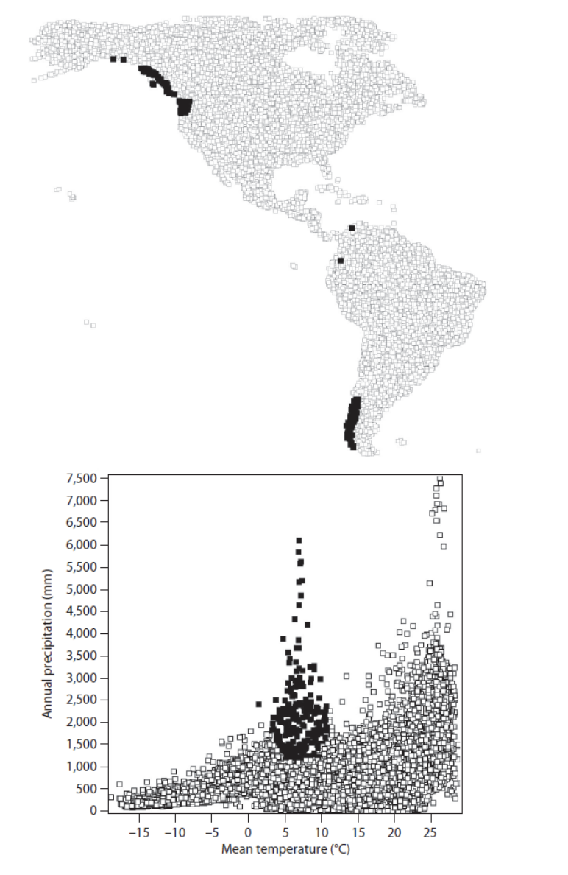
Relationships between ecological niches and geographic distributions
E-space
G-space
Set of tolerable environmental variables for the species
Geographic places these environmental conditions exist
Notes:
Image source UNKNOWN

Slide 6
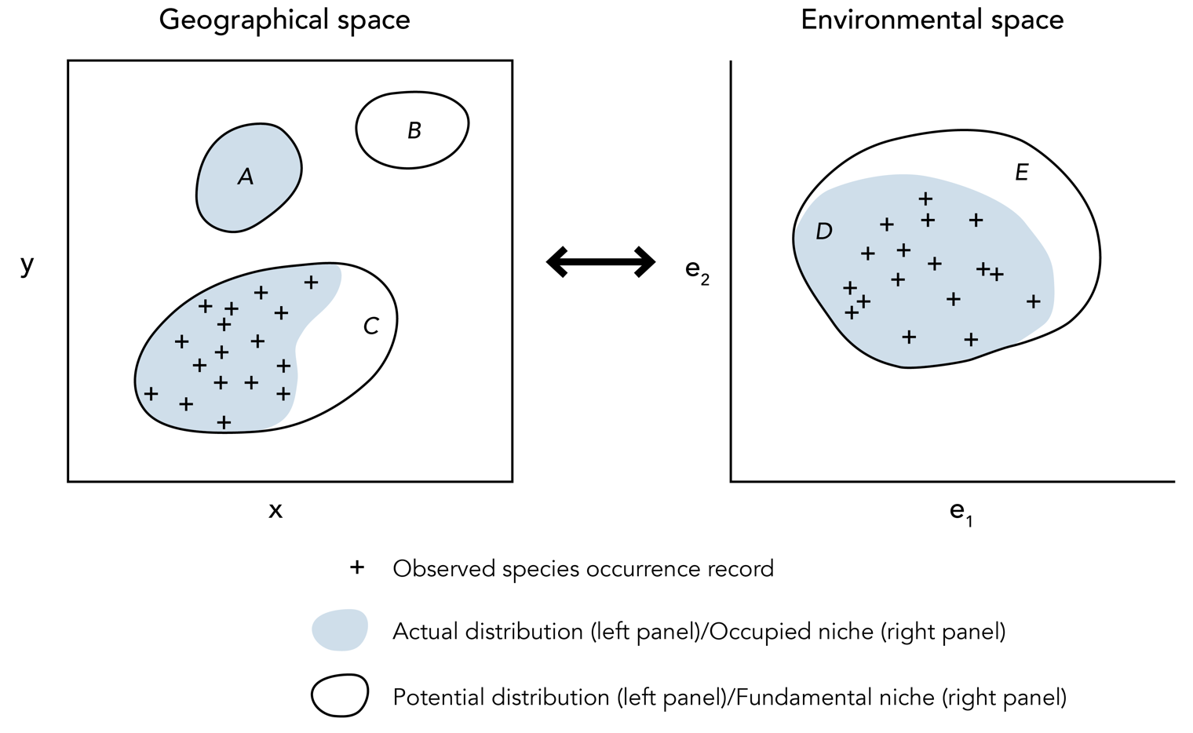
Relationship between species’ position in geographical space and environmental space
Notes:
Image credit: Modified by N. Gazit/CBC from Pearson 2007 NCEP module, “Species Distribution Modeling for Conservation Educators And Practitioners” and Peterson, A.T., J. Soberón, R.G. Pearson, R.P. Anderson, E. Martínez-Meyer, M. Nakamura, and M.B. Araújo. 2011. Ecological Niches and Geographic Distributions (MPB-49). Princeton University Press, Princeton, NJ, USA.

Slide 7
Relationship between species’ position in geographical space and environmental space
Notes:
Image credit: Modified by N. Gazit/CBC from Pearson 2007 NCEP module, “Species Distribution Modeling for Conservation Educators And Practitioners” and Peterson, A.T., J. Soberón, R.G. Pearson, R.P. Anderson, E. Martínez-Meyer, M. Nakamura, and M.B. Araújo. 2011. Ecological Niches and Geographic Distributions (MPB-49). Princeton University Press, Princeton, NJ, USA.

Slide 8
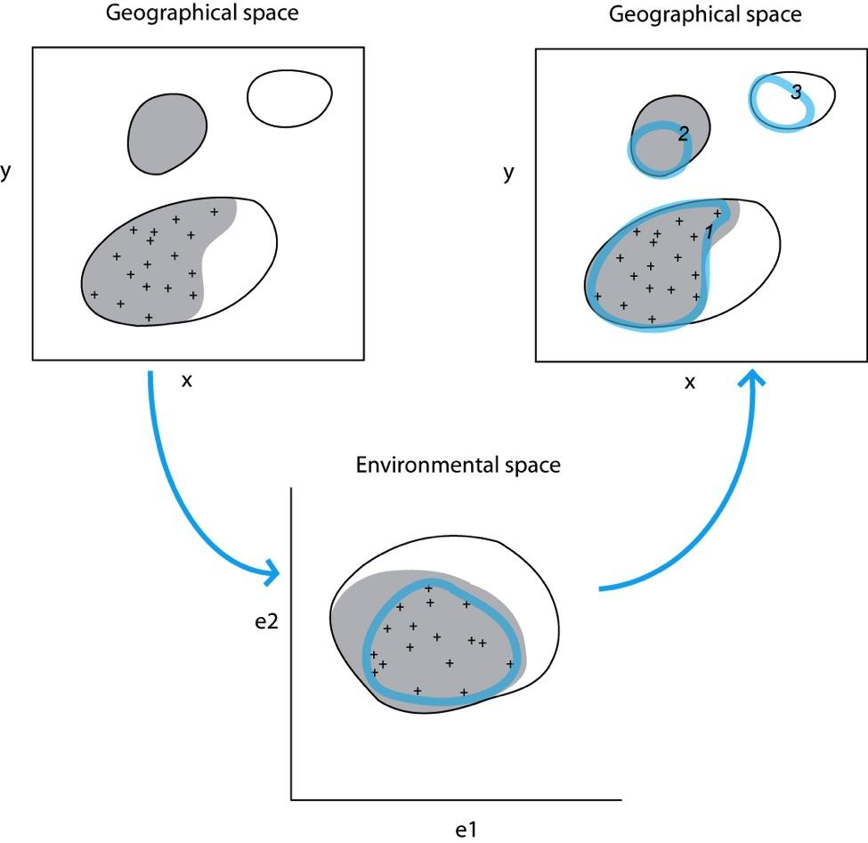
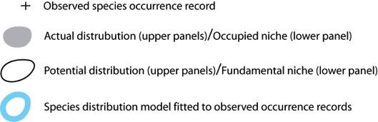
General Species Distribution Modeling Approach
Notes:
Image credit: Modified by N. Gazit/CBC from Pearson 2007 NCEP module, “Species Distribution Modeling for Conservation Educators And Practitioners” and Peterson, A.T., J. Soberón, R.G. Pearson, R.P. Anderson, E. Martínez-Meyer, M. Nakamura, and M.B. Araújo. 2011. Ecological Niches and Geographic Distributions (MPB-49). Princeton University Press, Princeton, NJ, USA.

Slide 9
Observed localities can be used to estimate the niche or distribution if:
1. They are at equilibrium with available environmental conditions.
2. They are a representative sample of the species in geographic and environmental space.

Slide 10
A = Range of environmental variables within which a species can survive
Fundamental
A
Invadable
B = Biotic interactions that limit/facilitate the persistence of a species
M = Geographic space available for species’ dispersal
B
Occupied
M
Soberón & Peterson (2005)

Slide 11
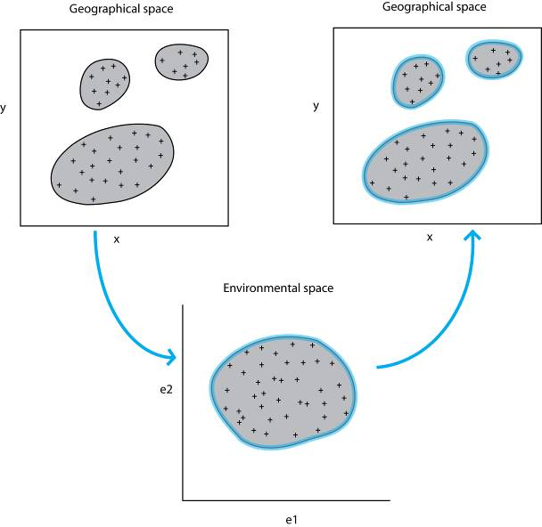
Suppose equilibrium and good sampling: the ideal scenario
Notes:
Image credit: Modified by N. Gazit/CBC from Pearson 2007 NCEP module, “Species Distribution Modeling for Conservation Educators And Practitioners” and Peterson, A.T., J. Soberón, R.G. Pearson, R.P. Anderson, E. Martínez-Meyer, M. Nakamura, and M.B. Araújo. 2011. Ecological Niches and Geographic Distributions (MPB-49). Princeton University Press, Princeton, NJ, USA.

Slide 12
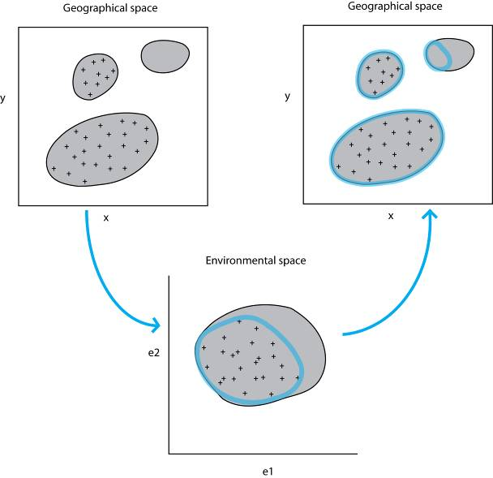
Suppose high equilibrium but poor sampling (in both geographical & environmental space)
Notes:
Image credit: Modified by N. Gazit/CBC from Pearson 2007 NCEP module, “Species Distribution Modeling for Conservation Educators And Practitioners” and Peterson, A.T., J. Soberón, R.G. Pearson, R.P. Anderson, E. Martínez-Meyer, M. Nakamura, and M.B. Araújo. 2011. Ecological Niches and Geographic Distributions (MPB-49). Princeton University Press, Princeton, NJ, USA.

Slide 13

Suppose high equilibrium and poor sampling in geographical space, but good sampling in environmental space
Notes:
Image credit: Modified by N. Gazit/CBC from Pearson 2007 NCEP module, “Species Distribution Modeling for Conservation Educators And Practitioners” and Peterson, A.T., J. Soberón, R.G. Pearson, R.P. Anderson, E. Martínez-Meyer, M. Nakamura, and M.B. Araújo. 2011. Ecological Niches and Geographic Distributions (MPB-49). Princeton University Press, Princeton, NJ, USA.

Slide 14
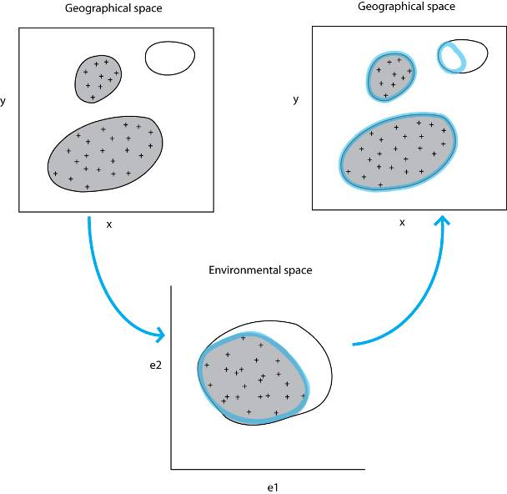
Suppose low equilibrium but good sampling
Notes:
Image credit: Modified by N. Gazit/CBC from Pearson 2007 NCEP module, “Species Distribution Modeling for Conservation Educators And Practitioners” and Peterson, A.T., J. Soberón, R.G. Pearson, R.P. Anderson, E. Martínez-Meyer, M. Nakamura, and M.B. Araújo. 2011. Ecological Niches and Geographic Distributions (MPB-49). Princeton University Press, Princeton, NJ, USA.

Slide 15
Back to our first example: in reality we have a combination of dis-equilibrium and incomplete sampling
Notes:
Image credit: Modified by N. Gazit/CBC from Pearson 2007 NCEP module, “Species Distribution Modeling for Conservation Educators And Practitioners” and Peterson, A.T., J. Soberón, R.G. Pearson, R.P. Anderson, E. Martínez-Meyer, M. Nakamura, and M.B. Araújo. 2011. Ecological Niches and Geographic Distributions (MPB-49). Princeton University Press, Princeton, NJ, USA.

Slide 16
Back to our first example: in reality we have a combination of dis-equilibrium and incomplete sampling
So, we must be very cautious when interpreting model output: to what degree have we been able to capture the potential and/or actual distribution?
Notes:
Image credit: Modified by N. Gazit/CBC from Pearson 2007 NCEP module, “Species Distribution Modeling for Conservation Educators And Practitioners” and Peterson, A.T., J. Soberón, R.G. Pearson, R.P. Anderson, E. Martínez-Meyer, M. Nakamura, and M.B. Araújo. 2011. Ecological Niches and Geographic Distributions (MPB-49). Princeton University Press, Princeton, NJ, USA.

Slide 17
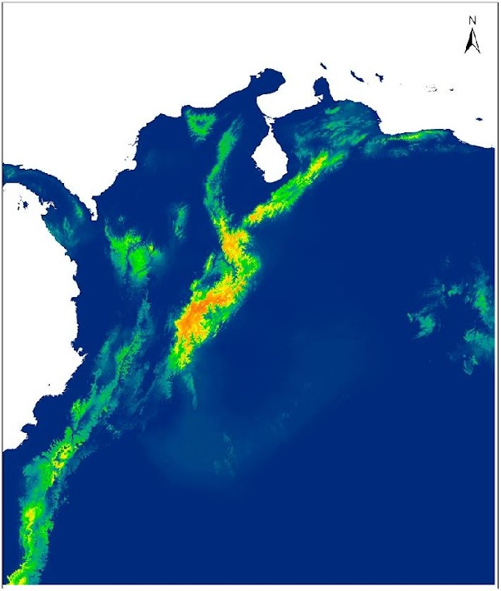
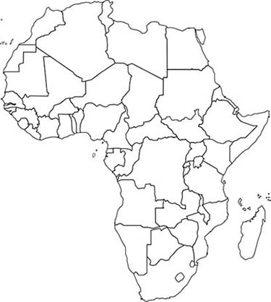
Species distribution models
.
.
.
.
.
.
.
.
Algorithm/model
E.g., Maxent, BRT, GARP, Bioclim, Linear regression, etc.
Predictor variables
Species presences
Suitable habitat
E.g., temperature, precipitation, topography,
soil type, etc.
E.g., presence, presence/absence
Notes:
Image credit: A. Paz, based on data used in: Paz, A., A. Gonzalez, and A.J. Crawford. 2019. Testing effects of Pleistocene climate change on the altitudinal and horizontal distributions of frogs from the Colombian Andes: a species distribution modeling approach. Frontiers of biogeography 11:e37055.

Slide 18
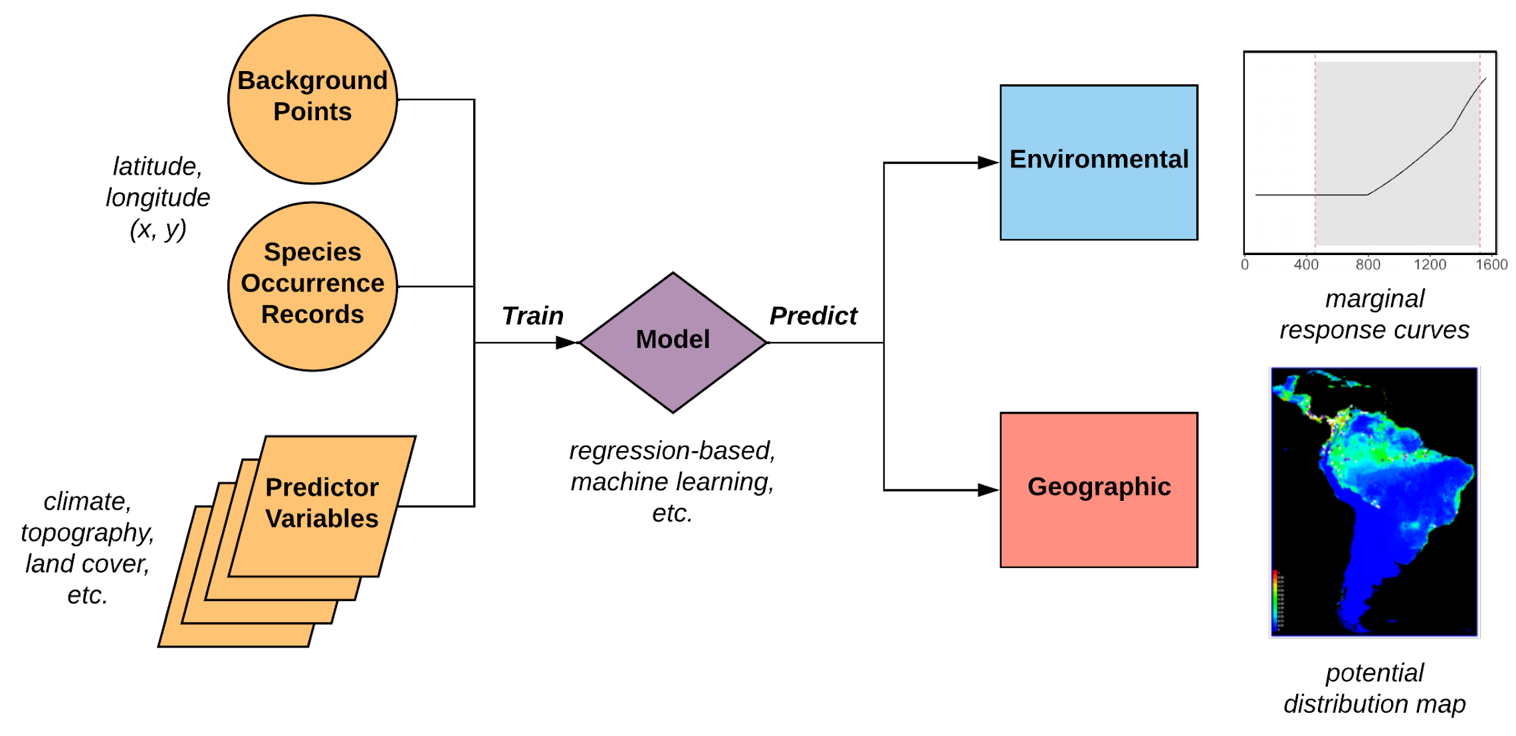
Species distribution models
Notes:
Image credit: Jamie Kass.

Slide 19
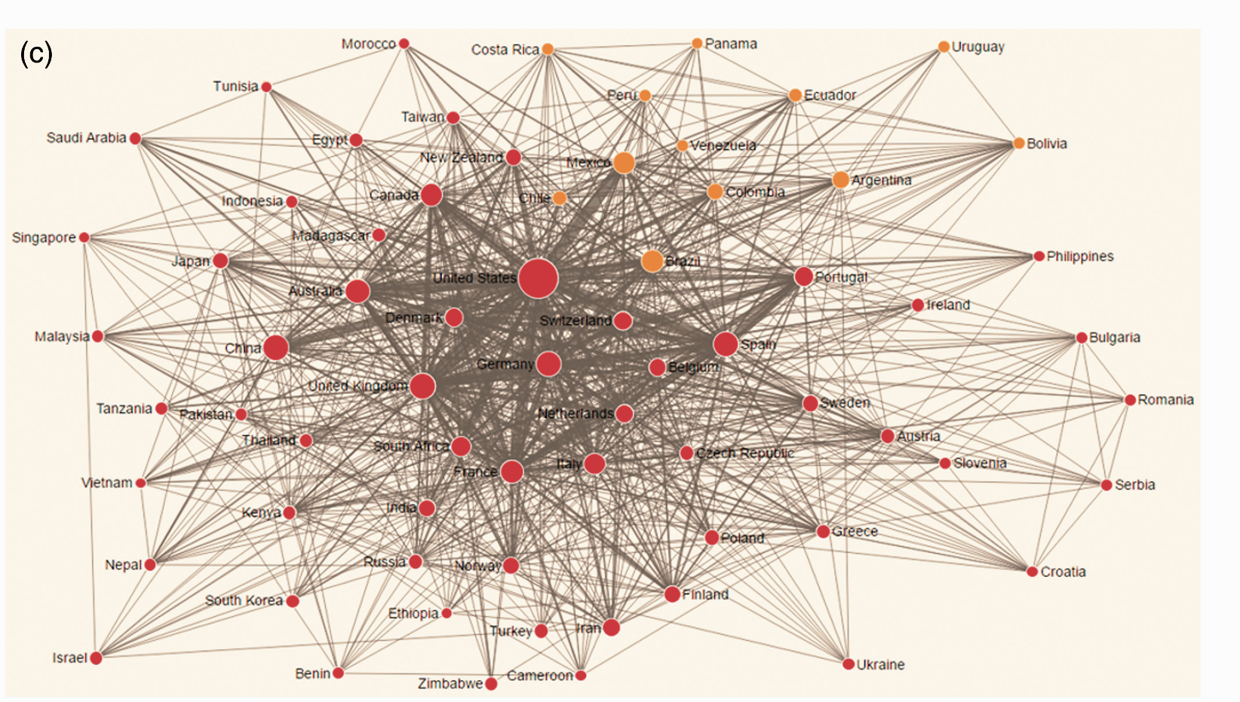
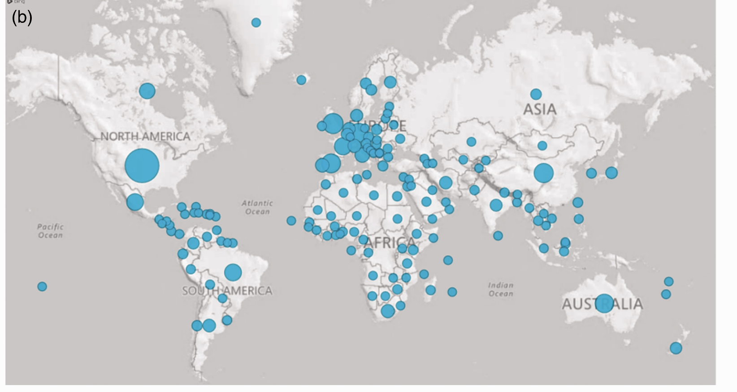
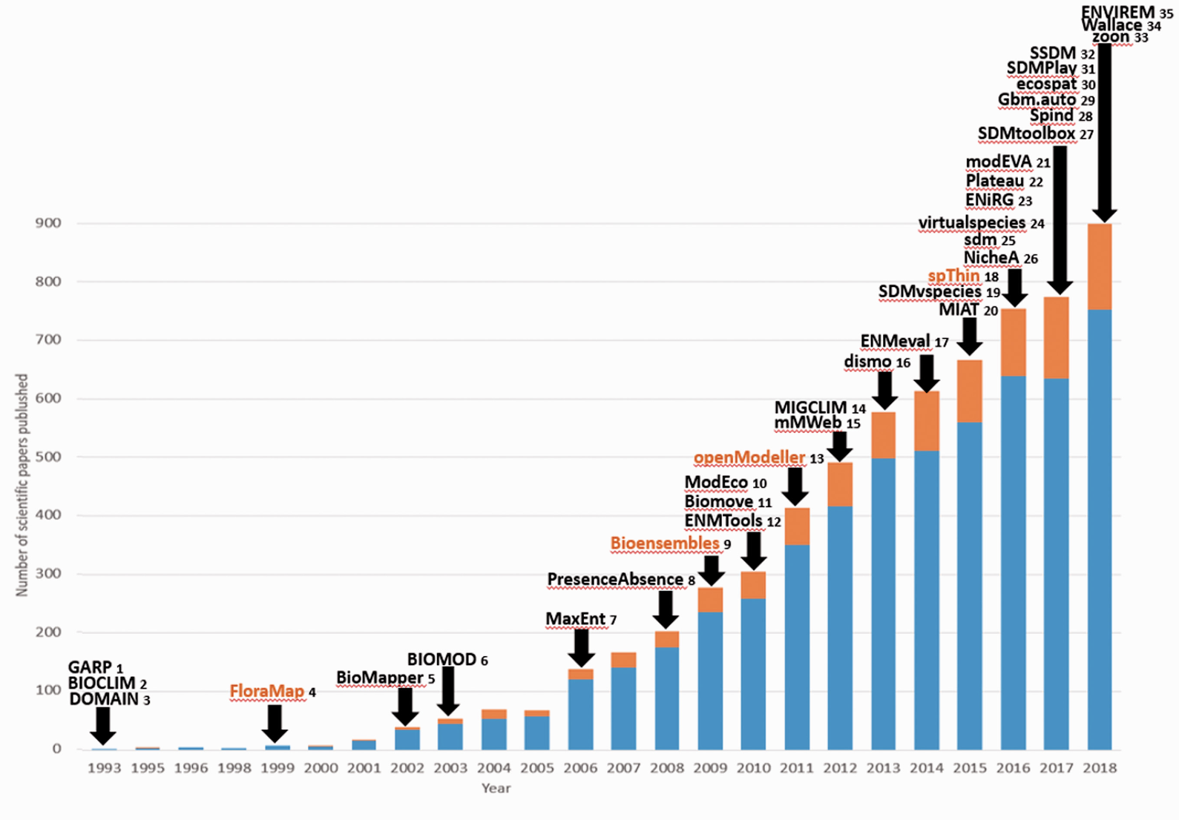
Species distribution models
Where and which?
Urbina-Cardona et al, 2019
Tropical Conservation Science
Notes:
Image credits: Urbina-Cardona, N., M.E. Blair, M.C. Londoño, R. Loyola, J. Velásquez-Tibatá, and H. Morales-Devia. 2019. Species distribution modeling in Latin America: a 25-year retrospective review. Tropical Conservation Science 12. doi:10.1177/1940082919854058 [CC-BY-NC-4].

Slide 20
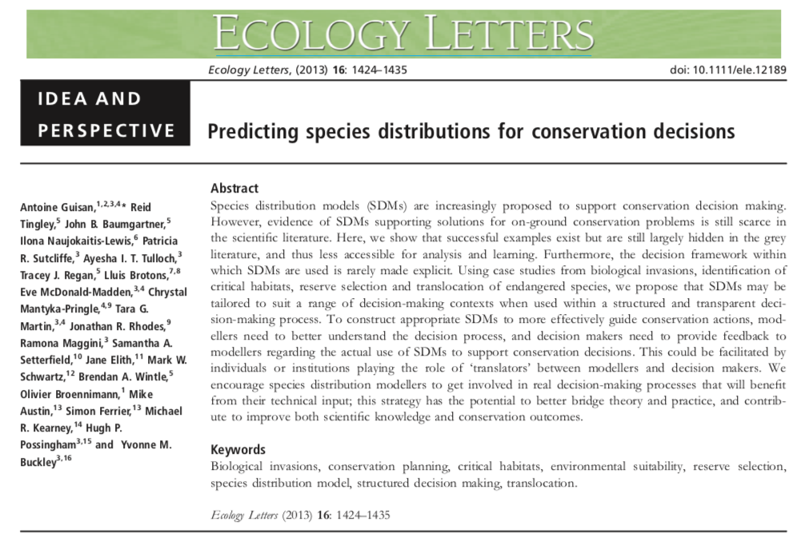
Applications to Conservation Science
Notes:
Screenshot of journal article: Guisan, A., et al. 2013. Predicting species distributions for conservation decisions. Ecology Letters, 16(12):1424–1435. Available from: https://doi.org/10.1111/ele.12189.

Slide 21
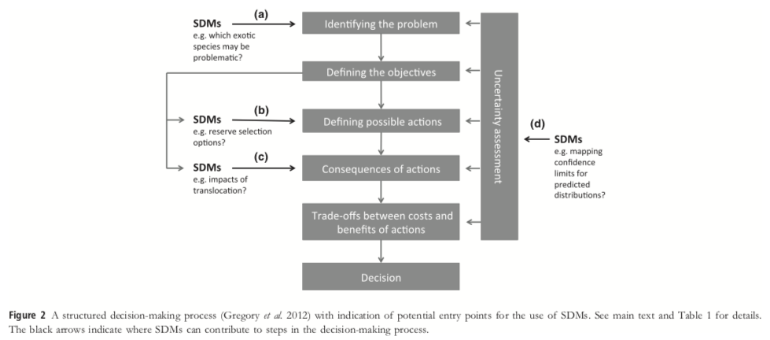
Applications to Conservation Science
Notes:
Image credit: Guisan, A., et al. 2013. Predicting species distributions for conservation decisions. Ecology Letters 16(12):1424–1435. Available from: https://doi.org/10.1111/ele.12189 [CC BY-NC-ND 3.0 DEED].

Slide 22
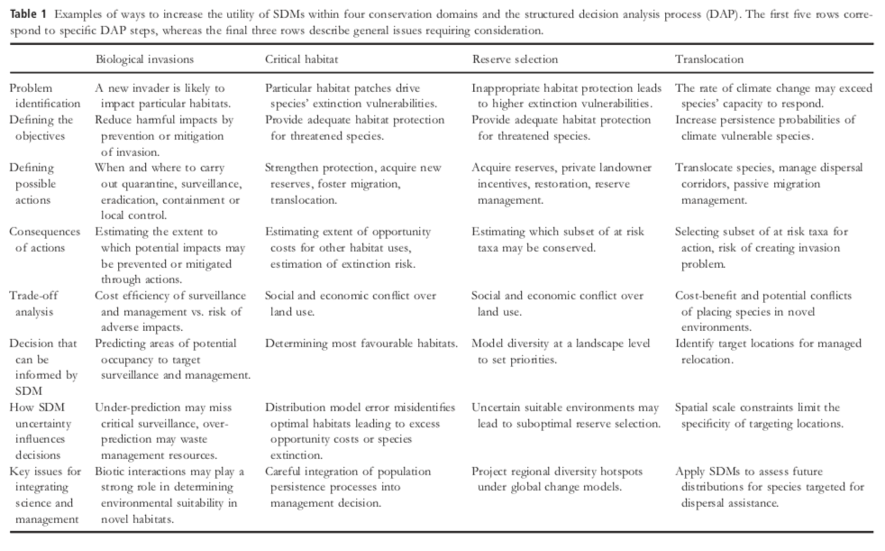
Applications to Conservation Science
Notes:
Table from: credit: Guisan, A., et al. 2013. Predicting species distributions for conservation decisions. Ecology Letters 16(12):1424–1435. Available from: https://doi.org/10.1111/ele.12189 [CC BY-NC-ND 3.0 DEED].

Slide 23
Final Cautionary Notes!
The use and misuse of models
“All models are wrong, but some are useful” George Box
Garbage in, garbage out: a model is only as good as the data put into it.
Model extrapolation: should be treated with a great deal of caution.
The lure of complicated technology: Remember that a model can only be useful if the theoretical underpinnings on which it is based are sound, regardless of how advanced the data and technology are.

